Slide 1

California Hospital
Emergency Food Planning Guidance and Toolkit
CHA Webinar
Recorded on May 30, 2013

Slide 2
Welcome
Cheri Hummel
Vice President, Disaster Preparedness
California Hospital Association

Slide 3
Webinar Purpose
  To review the California Hospital Association Emergency Food Planning Guidance and Toolkit
  To address Emergency Food Planning within the broader context of hospital Emergency Operations Plans
  To assist hospitals with understanding how to best use these resources and tools in their planning efforts

Slide 4
Faculty: Jan C. Spencley
Jan C. Spencley is a CHA Hospital Preparedness Coordinator and healthcare consultant with over 30 years of experience. Jan has worked for UCSD Healthcare, where she was actively involved in the development of the local trauma system and the UCSD trauma center. For the past 10 years, Jan has been a consultant working with hospitals and health systems, medical groups, community health centers, health plans and local government. Her consulting engagements have included strategic and operational planning, performance improvement and disaster planning.

Slide 5
Faculty: Connie Lackey
Connie Lackey is a registered nurse at Providence Saint Joseph Medical Center in Burbank. Connie served as Disaster Preparedness Coordinator from 1996-2007 and Disaster Resources Center Manager since 2004. She is the Manager of Emergency Preparedness for the Providence San Fernando Valley Service Area covering Saint Joseph, Holy Cross and Tarzana Medical Centers. Connie is a member of the LA County National Bioterrorism Hospital Preparedness Program Steering Committee and the Providence Health System Disaster Preparedness Task Force and serves as LA County TEW Medical Liaison Officer.

Slide 6
Faculty: Carol Granados
Carol Granados, MA, RD, CDE is the Director of Hospitality Services for Providence Saint Joseph Medical Center. Carol has worked as a Clinical Nutrition Manager for 20 years in both acute and long term care settings. She is a Certified Diabetic Educator for high risk Perinatology practice and inpatient diabetes educator. Carol has served as a Lecturer for the American Heart Association and the Stroke Foundation and is a member of the CSUN Advisory Board for Dietetics and guest lecturer for the Dietetics Internship program.

Slide 7
California Hospital
Emergency Food Planning
Guidance and Toolkit
Jan C. Spencley
CHA Hospital Preparedness Program
Connie Lackey, RN
Providence Saint Joseph Medical Center
Carol Granados, MA, RD, CDE
Providence Saint Joseph Medical Center

Slide 8
Before we get started
  Please print the Hospital Emergency Food Supply Planning Guidance and Toolkit before viewing this webinar
  It will be helpful to have the printed documents as they are reviewed or referenced during the webinar

Slide 9
Agenda
  Introduction – Purpose and Background
  Overview
  Regulatory – Accrediting Agency Requirements
  Guidance – Recommendations Overview (Attachment B)
  Emergency Food Calculation Tool (Attachment C)
    Walk-through
    Hospital Specific Assumptions and Calculations Summary
  Summary

Slide 10
Overview:
Purpose of Guidance
  To provide guidance and tools to hospitals in planning for, and documenting, emergency food supplies
  Objectives:
    Establish “basic” assumptions for emergency food supply planning needs consistent with regulatory agency requirements
    Provide a Tool to allow hospitals to apply and document planning assumptions used to identify emergency food needs
    Ensure Tool is scalable and customizable to address individual hospital size, situation and preferences
    Provide Guidelines and Recommendations to address other food related issues identified by hospitals

Slide 11
Overview: Development
  Advisory Group (Attachment A)
    CHA Hospital Preparedness Program Staff
    Hospital Nutrition Managers and Directors
    Hospital Emergency Preparedness Coordinators
  Process
    Staff research and summaries
    Advisory Group input and revisions
    Numerous iterations of Tool and Guidance
    Incorporate regulatory guidance
    (at time of publication)

Slide 12
Emergency Food Planning and Guidance Toolkit: Contents
Section | Contents
Narrative | Hospital Emergency Food Planning Guidance (Narrative)
Exhibit 1 | Emergency Food Planning Flow Diagram
Exhibit 2 | Emergency Food Response Flow Diagram
Attachment A | Hospital Emergency Food Advisory Group
Attachment B | Key Guidance and Recommendations
Attachment C | Emergency Food Planning Tool (Excel Workbook)
Attachment D | Emergency Food Planning Tool Instructions
Appendix A | Key Regulatory References
Appendix B | Key Accrediting Agency References

Slide 13
Regulatory – Accrediting Agency
Food Supply Overview
  State: Title 22 and Title 24 (Appendix A)
    One week (7 days) supply of staple foods
    Two (2) day supply of frozen/perishable foods
    Disaster program with provision of “adequate” food supplies
  Federal: CMS (Appendix A)
    Supplies needed in likely emergency situations
    Adequate provisions to ensure availability when needed
  The Joint Commission (Appendix B)
    Emergency Operations Plan addresses 96-hour plan
    Inventory and plan to replenish resources
    Plan for staff/family support needs
  Others (NFPA, HFAP, DNV) – Less prescriptive (Appendix B)
Notes:
This Toolkit addresses food supplies, and not “plans” – so regulatory references primarily focus on those areas
Assume you understand the rules regarding the menu, storage, safety, etc.

Slide 14
Guidance and Recommendations
Highlights (Attachment B)
  Emergency Food Plan Scenario: Potential/actual disruption of supply chains and no/limited access to community support
  Hospital Priority: Primary, critical responsibility for patient care during a major disaster – conserving resources to meet the needs of existing patients, victims presenting to hospital, and essential staff to care for patients and maintain operations
  Emergency Food Plans: Consistent with Hospital Emergency Operations Plan (a team effort)
    Visitor restrictions – cafeteria closure
    Food supply and perimeter security
    Conservation of resources
Notes:
Scenario: Think about what would cause you to activate your Emergency Food Plan? If a disaster happens, it is highly unlikely that you will have a full situation status for some time. If interstate highways and bridges collapse, your suppliers are not likely to be able to make deliveries to you. Your local jurisdiction will be dealing with major infrastructure concerns, secondary impacts, and mobilizing for care and shelter of those in the community displaced by the event. Until you can CONFIRM that your suppliers are making deliveries to resupply your facility, you need to activate your plan (SIP)
Priority must be on your patients – both those already under your care and the victims of the event – and on essential staff. Essential staff are those needed to care for patients and maintain essential hospital operations.
The plans and food supplies should be consistent with the hospital Emergency Operations Plan -- which we hope would call for some level of immediate lockdown.

Slide 15
Guidance and Recommendations
Highlights (Attachment B)
  General
    Emergency Operations Plan and Use of HICS
    Early activation and assessment (with Command Center)
  Plans and Procedures
    Resources are consistent with plans (power, water, etc.)
    Written Emergency Food Plans (menus, equipment, operations) are consistent with food supply calculations
  Inventories
    Identify patient inventories separate from non-patient
    Document regular review of inventory (for levels/expiration)
    Ensure supplies are “on premises”

Slide 16


The Hospital: If the Lights Are On
They Will Come
Emergency Plans should address immediate lock-down and traffic control so the hospital can serve victims and patients
If you choose to provide care and shelter to the community, please do not address those services, resources or plans in your acute care hospital plan — stick to licensed hospital services
Notes:
After a major disaster that could actually result in activation of your emergency food plan – and if you are lucky, the hospital may be the only place in your area with the lights on
And a frightened community may well head towards the light – your hospital needs to be ready to send those who are not injured to community resources – you cannot be the community shelter without compromising your primary patient care mission. This has happened – not just in other areas of the country, but right here in California. Chinese hospital in San Francisco had such an experience – the residents of the area congregated around the hospital blocking ambulances and other traffic coming to the hospital.
And, if you are planning to serve the community, then please do not make that part of the Acute Care Hospital Plan. Have a separate plan for services and programs not on your acute care license – and outside of licensed care space. But please note, unless you are a designated shelter site, you will not receive reimbursement for sheltering services – designated shelters will.

Slide 17
Emergency Food Planning Tool
Basic Overview (Attachment C)
  Emergency Food Supply Plans
    Who does the hospital plan to feed?
    What will each population category be fed?
    How often will they be fed and for how long?
  Hospital will be reviewed for compliance with its own plans (after minimum regulatory requirements met)
  Corresponding Plans: How will they be fed?
    Meal tickets – Accountability
    Patients versus non-patients
    Cafeteria versus food stations
    Food security (internal and external)
  You will have difficulty assessing status without controls

Slide 18
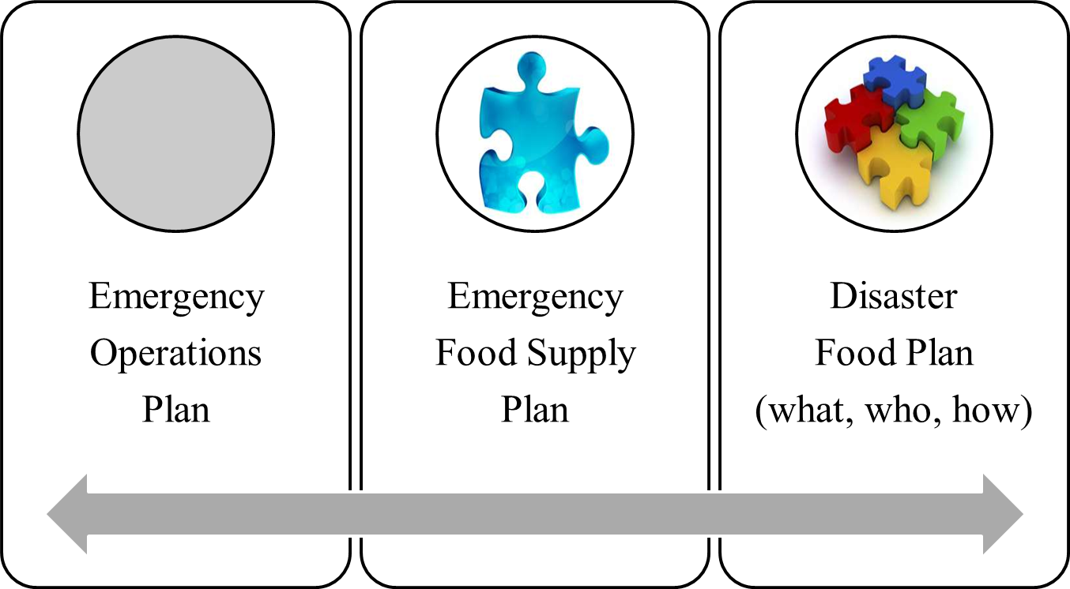

The Emergency Food Supply Calculations are One Piece of an Integrated Puzzle
Notes:
EOP – HVA, security, essential staff, physicians, etc., what is surge capacity, visitor limitations, services, etc.
That will drive the Emergency Food Supply Plans
But your Disaster/Emergency Food Plan also needs to address:
The menus, food service staffing, just in time training, safety, equipment and back-up equipment, emergency power (where/what)

Slide 19
Emergency Food Plan
Calculation Tool
  Planning Scenario
    Based on historical sources and assumptions
    Developed with hospital Emergency Preparedness Coordinator
    What hospital will be reviewed on by regulators
  Targets vs. planning (targets not in plan until met)
  Event Scenario
    Actual situation – new assumptions
    Adjust your Tool – event name/date/time
    Adjust your strategies to event realities

Slide 20
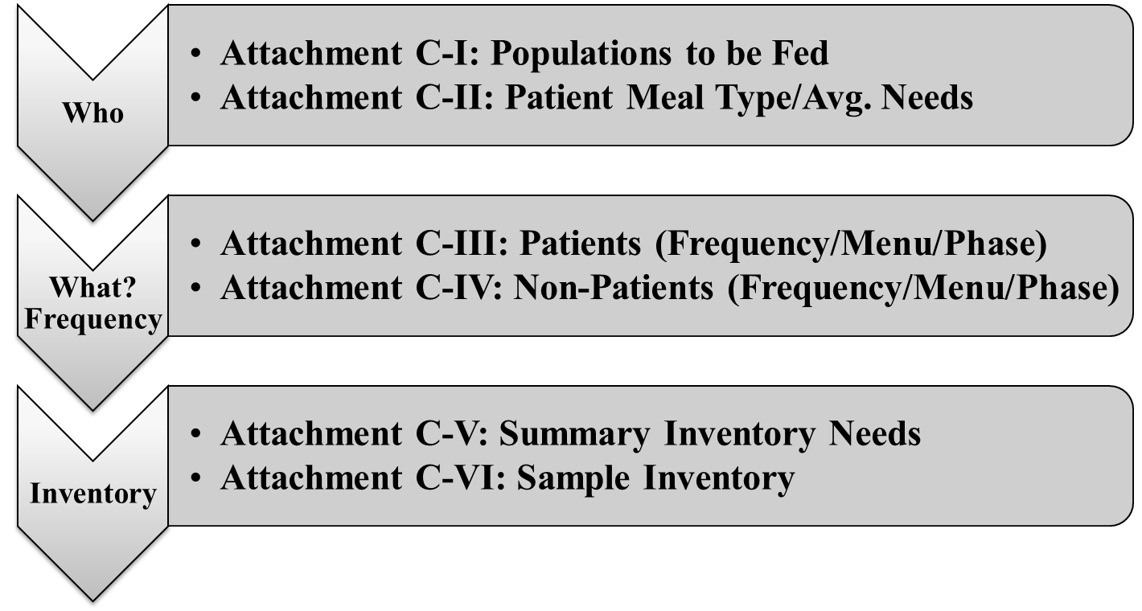
Emergency Food Calculation Tool
Attachment C – You Already Do This
Notes:
The Excel Workbook may seem daunting – but the reality is that in some form or another you already calculate each of these steps
The issue is that they are not tied together – your assumptions are not tied to your plans or your inventories
If you make a change, you must recalculate everything. With this tool, you link who you feed to your needs to how and what you feed each population and, therefore, what your inventory needs are.

Slide 21
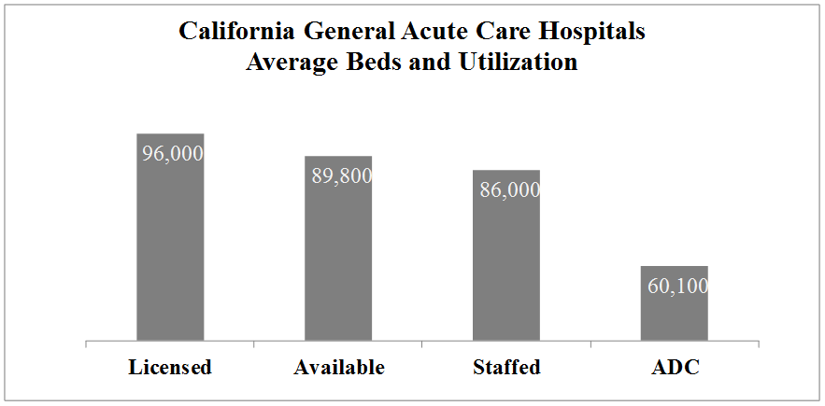
Licensed Beds: Reasonable
Minimum for Surge
Staffed Beds Are 90% of Licensed
Source: www.oshpd.ca.gov – 2011 Q3 Reports; GAC only
ADC = Average Daily Census
Notes:
Before we move to the Tool itself, let’s discuss surge and what reviewers expect.
California Average Daily Census is approximately 62% of Licensed Beds for General Acute Care hospitals (this excludes free standing psychiatric, state hospitals and long term care emphasis facilities) – but we know these are averages and that census rises and falls by day of week and month of year – so often, there are more patients than reflected by the ADC
On average, staffed beds are 90% of Licensed – so licensed/surge level is about a 10.4% higher census. Surge also assumes that hospitals are cancelling scheduled admissions and assessing patients for discharge either to home or a lower level of care. So capacity is created both through expansion and reductions.
These figures vary by hospital so your estimates should be based on your reality, your census and perhaps recent changes in services. Surge plans may also call for numbers higher than 100% of licensed beds – but those figures are unique to your organization. Licensing seems to survey to a minimum of licensed beds for emergency food – so we established licensed beds as a floor in the tool assumptions.
Now, let’s move to the Tool itself

Slide 22

California Hospital Emergency
Food Planning Tool

Slide 23
Providence Saint Joseph Medical Center
Example Assumptions – Population
  Basic Needs
    Shows baseline above which hospital will surge
    257 average staffed beds (per www.oshpd.ca.gov)
  Surge Targets: Patients and Staff
    Surge (100% of licensed beds) – 414
    Essential Staff
      Clinical Staff (24/7 positions not people)
      Ancillary Clinical Staff (60% of 24/7 positions)
      Security/Plant Ops/Housekeeping (50% of staff)
      Non-Clinical Staff (25% to pool/designated positions)
      Total Staff of 422 staff divided by 414 = 1.019 staff to patient ratio
Notes:
Now we will walk through an example of how one hospital is using the Guidance and Tool for planning.
Connie, can you please review how you identified your baseline and then your surge targets for both patients and staff
Our assumptions for Attachment C – Worksheet 1 are start with our staffed beds – these are easily found on the OSHPD website and show an average over a period of time. Surging to our licensed bed capacity is a stretch for us – but that is what we are planning for.
For essential staff – employees – we are planning to keep as many as possible but recognize that will be a challenge. We also want to ensure that we conserve resources. So, our assumptions are:
REVIEW assumptions

Slide 24
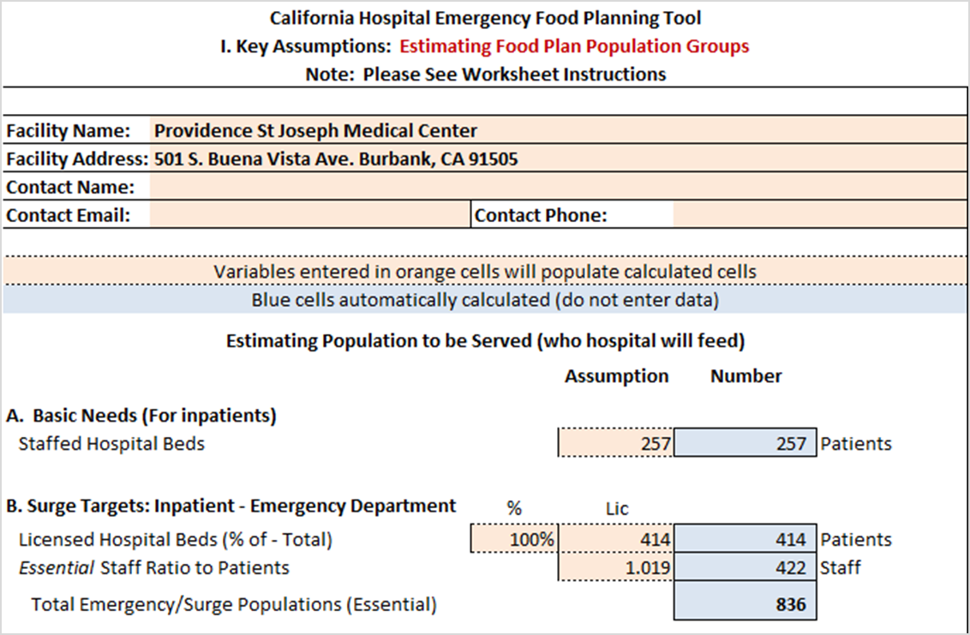
Providence Saint Joseph Medical Center
Example Assumptions – C-I Populations

Slide 25
Providence Saint Joseph Medical Center
Example Assumptions – C-I Populations
  Surge Targets: Optional Populations
    Staff Family (per staff members = .024 ratio to staff)
    Visitors (1 per 5 patients = .20 ratio to patients)
    Rooming In (1 per 20 patients = .05)
    Physicians – Hospital Based (13 ÷ 414) = .03 per patient
    Physicians – Rounding (24 ÷ 414) = .058 per patient
    Volunteers (19 ÷ 414) = .047 per patient
  Results
    After entering these ratios, the Tool will calculate and identify a total number for each category – Patients, Staff and Others
    If patient/staff assumptions change, others automatically update to reflect higher need unless you update them
    All results from this worksheet will carry over to subsequent worksheets
Notes:
Our intent is to provide information on how to get to community shelters and other resources as we simply cannot become the source of shelter or food to the community.
We have worked with our staff to establish an expectation that they will have emergency plans so that they can come to work; while not foolproof, it is our expectation. As a result, we do not expect to have large numbers of family members or dependents to care for.
We are assuming that at the time disaster strikes, for every 5 patients there will be one visitor in the hospital - a .20 ratio of visitors to patients. If we cannot get supplies, we do not believe that visitors will have an easy time coming to the hospital but we will also limit visitors and ask that they bring their own food supplies with them. Our cafeteria will be closed.
We used our historical experience for Rooming In but also assume that surge patients will not have the same level of rooming in. So, we used 1 per 20 patients (or about 5%)
We looked at our Total Hospital Based Physician positions – and assumed one full shift would be there – so divided by total patients that is .12 per patient
We assume approximately 24 physicians rounding on patients – that equates to about .058 per patient
With a combination of hospital and disaster volunteers, we assume around 19 volunteer positions – or .05 per patient

Slide 26
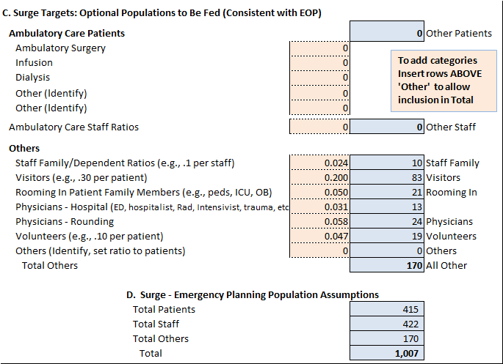
Providence Saint Joseph Medical Center
Example Assumptions – C-I Populations
Notes:
Jan: The second half of this worksheet includes the other populations the hospital may need to support.
Connie outlined her assumptions regarding these populations – and has taken a relatively hard line on preserving hospital resources for patients and essential staff.
The results of this worksheet are summarized at the bottom – but for optional populations, the hospital can make further adjustments later in the process.

Slide 27
Providence Saint Joseph Medical Center
Assumptions – C-II Patient Meal Requirements
  Section A – Patient Nutritional Needs Per Day
    Patient Breakdown is based on historical patient populations adding in Newborns who are not usually in census data
    Basic Daily Needs are based on our Nutrition Standards derived from National IOM Guidance (DRIs)
  Section B – Patient Meal Type Breakdown
    Collected and analyzed meal types for several days and shifts
    Established an average percent of total for each meal type (including newborns)
    We have a disaster menu for each meal type that seeks to minimize menu variances while addressing special needs
Notes:
Carol – how did you develop assumptions for specific daily nutritional needs for your patients and identify meal requirements to complete Worksheet C-II?
Carol to review the slide.
We identified our historical base of patient age and life/stage and then identified Basic Daily Needs base don our Nutrition standards – these are derived from the National Institute of Medicine Guidance. This resulted in estimated average caloric needs for our population.
We then collected and analyzed meal types for several days and different shifts – how many were normal, diabetic, mechanical, etc.
From that information we were able to identify what percent of our total patients fall into each meal type – including newborns.
As you will see later, we have a disaster menu for each meal type.

Slide 28
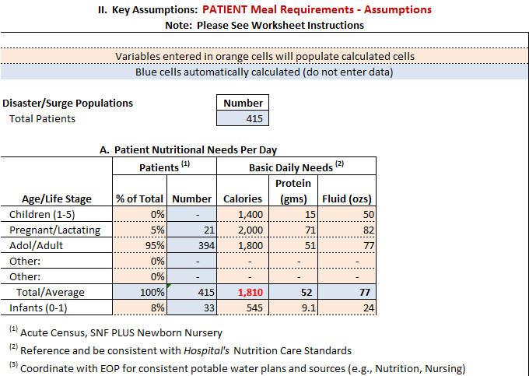
Providence Saint Joseph Medical Center
Assumptions – C-II Patient Meal Requirements
Notes:
So we entered are our historical patient breakdown by age and life/stage and their caloric needs
And, we determined our average patient caloric requirement to be approximately 1,810 per day

Slide 29
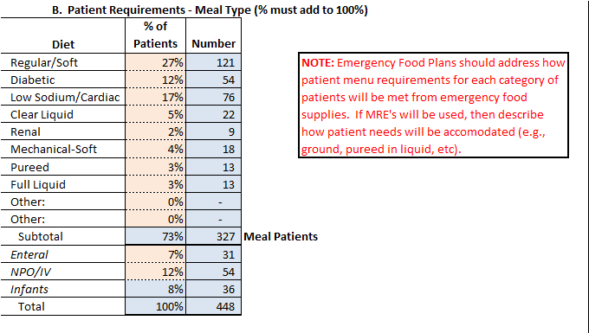
Providence Saint Joseph Medical Center
Assumptions – C-II Patient Meal Requirements
Notes:
Carol:
As noted before, from our data collection, we identified our average breakdown by meal type – we entered this into the worksheet.
While there are 415 patients – newborns have been added. It is assumed that babies will continue to be born during a disaster.
This identified meal patients compared to those receiving nutrition through other means, as well as meal types which and we will review how we are handling that in a moment.

Slide 30
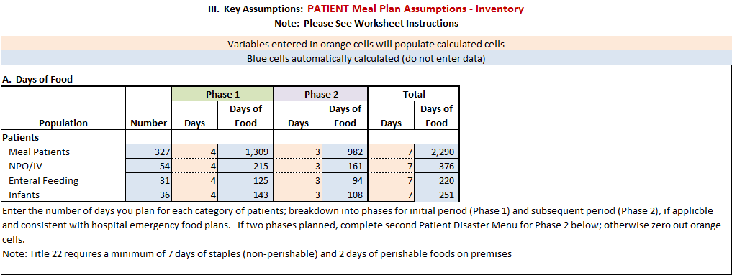
Providence Saint Joseph Medical Center
Assumptions – C-III Patient Meal Plans
Notes:
Our disaster menu calls for two phases – the first phase being to utilize perishables and other food stuffs. The second assumes that our supply chain is disrupted and we must move to alternatives.
We identified how many days for each Phase for each patient category – Meal and non-meal.

Slide 31
Providence Saint Joseph Medical Center
Assumptions – C-III Patient Meal Plans
  Rationale for Phase I and Phase II
    Use perishables, other food stuffs, and specialty tube feeding on hand in Phase I assuming availability of power for safe storage or preparation (if not, shift to Phase II)
    Financial burden of purchasing, maintaining and replacing 7-day inventory of regular food stuffs
    Storage limitations for maintaining large inventories of perishable and regular food stuffs
  Rationale for Use of Ensure in Phase II for “Meals”
    Increased shelf life and ease of storage
    Easier rotation and less costly replacement
    Ease of service (no utensils or preparation)
    Portability in case of evacuation
Notes:
Carol, can you please review your rationale for two disaster food planning phases? And then for your use of ensure
Carol: Review the slide
Note that Infants and other Patients not able to consume food orally are addressed with appropriate supplements and/or enteral formula supplies

Slide 32
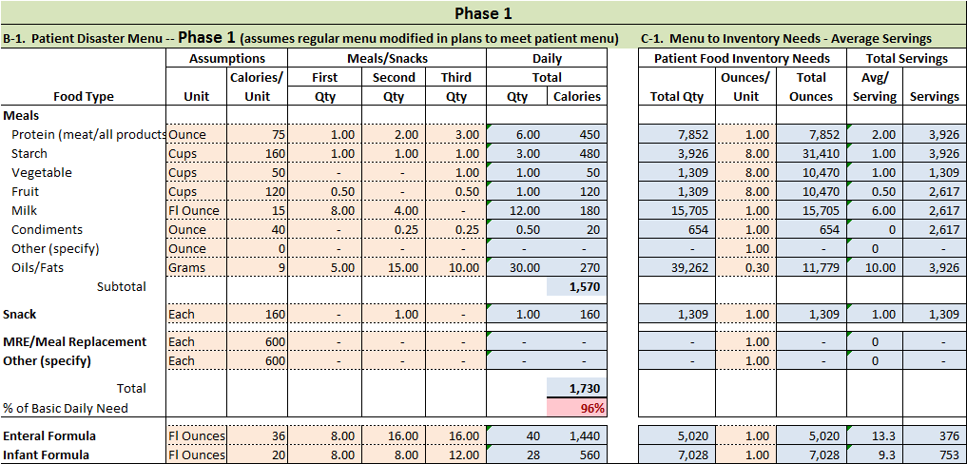
Providence Saint Joseph Medical Center
Assumptions – C-III Patient Meal Plans
Notes:
So, here is how the Providence Phase I average disaster menu plan looks
Carol – can you please review the menu and why the red % indicates that it is less than the average daily need identified?
Carol:
First, our menu plan includes using up perishables and frozen foods, as well as other food stuffs in the first 4 days. We address both meal patients and those not able to eat solid food.
We have targeted our average menu to stay well within the 90% of caloric needs for disaster menus required by…

Slide 33
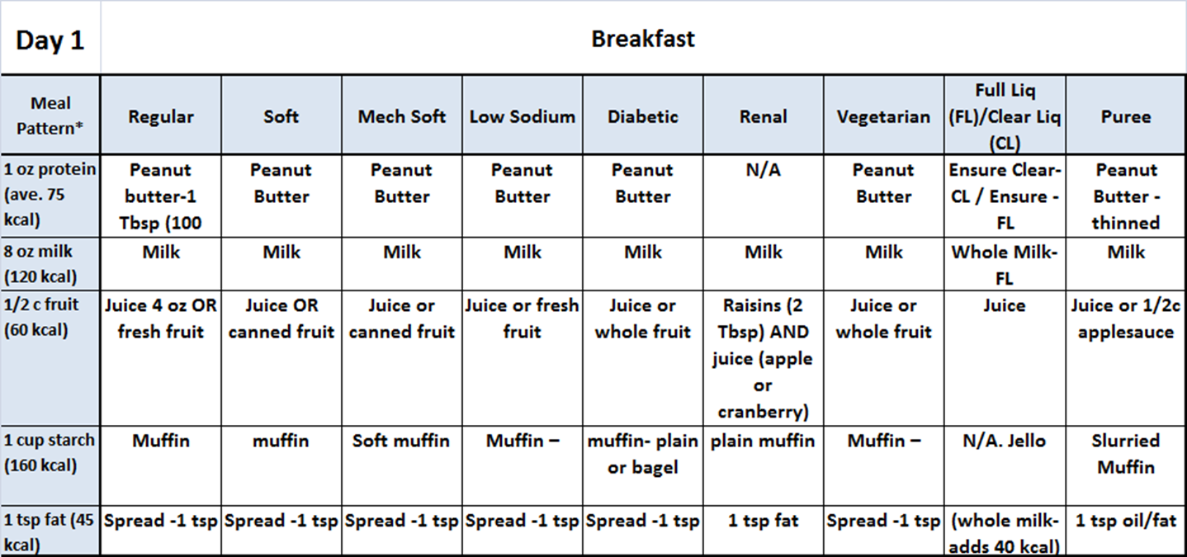
Providence Saint Joseph Medical Center
Assumptions – C-II Sample Disaster Menus
Notes:
This chart is an example of how we are seeking to simplify our disaster menu by patient meal requirements – or meal pattern – for those patients that can take their nutrition by mouth. We feel it is important that our menus be as simplified as possible with only a few variations to meet specific patient needs and physician orders.
This is only a sample of one meal – but we are looking at developing our plan to cover each meal by day for the first four days.

Slide 34
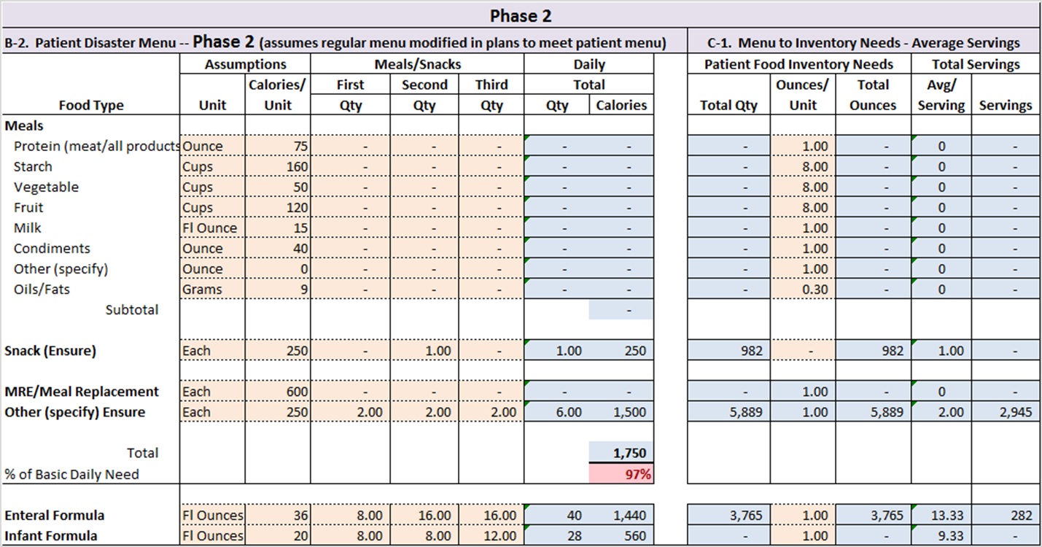
Providence Saint Joseph Medical Center
Assumptions – C-III Patient Meal Plans
Notes:
Carol, your Phase II Meal Plan looks quite a bit different than the first 4 days. This appears to be due to the use of Ensure as a meal replacement. How do you think this will go over with patients?
At this point, we must assume that we are still in dire straits – that our supply chain is broken and we are conserving all resources.
We must also assume that we do not have normal staffing – and those employees that are at work have been here for some time.
If we get to Phase II, we need to assume that we closed the cafeteria long ago, that we are using tickets to issue any food, and that we are evaluating how much longer our hospital can safely care for patients.
At this point, it is not about patient satisfaction, but patient health and sustenance. Ensure is a very feasible method and critical to continuing to provide for the caloric and nutritional needs of our patients.

Slide 35
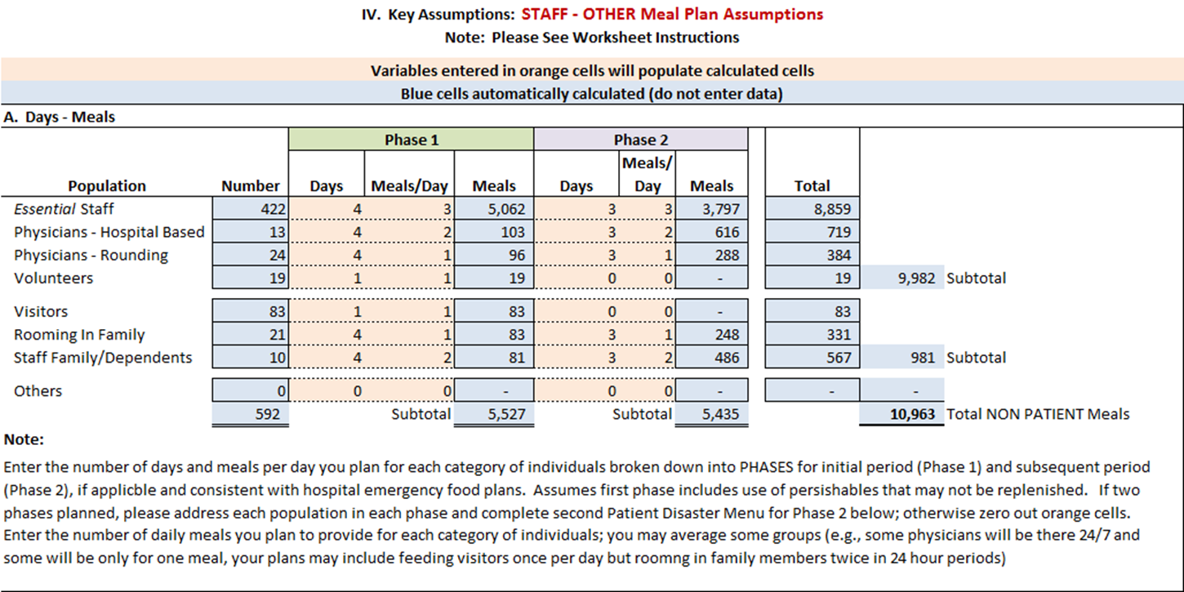
Providence Saint Joseph Medical Center
Assumptions – C-IV Non-Patient Meal Plans
Notes:
Connie, from this worksheet, it would appear that you plan to take a two phased approach for staff and other individuals – and that you do not plan to feed all of them 3 meals a day.
Connie:
As I have said before, our first priority must be our patients and the staff caring for them.
So staff we will feed – hospital based physicians we will feed but assume they will find a way to leave for a period of each day and eat elsewhere. We assume our community physicians will not be at the hospital all day – but will come by to round on their patients – so we are assuming one meal for them.
Volunteers will be asked to bring their own food – as will visitors. Rooming in Family will also be asked to secure most meals outside the hospital – whether at shelters or home. We will provide some food for staff dependents, but we simply must assume they will be able to secure food through other means for at least one meal a day.
Overall, I cannot emphasize enough the challenge with maintaining 7 days of food for this many people -- we cannot serve as a shelter, we are a hospital taking care of our patients and victims of a disaster.

Slide 36
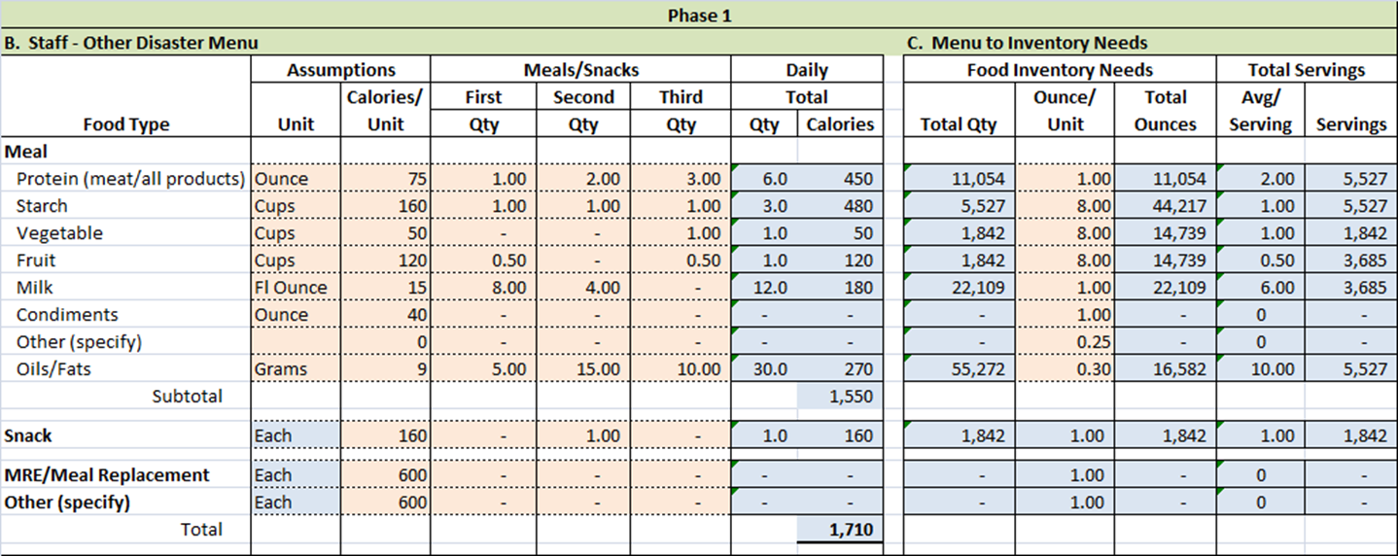
Providence Saint Joseph Medical Center
Assumptions – C-IV Non-Patient Meal Plans
Notes:
So we have meals for the first four days – or less if we are without power

Slide 37
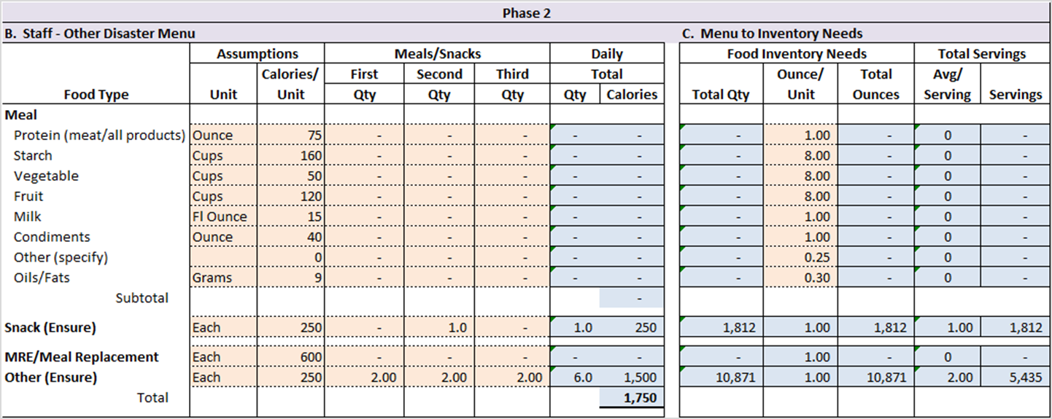
Providence Saint Joseph Medical Center
Assumptions – C-IV Non-Patient Meal Plans
Notes:
And we have ensure for the next 3 days – by which time supply chains have been re-established or we will already be planning for evacuation of our facilities.

Slide 38
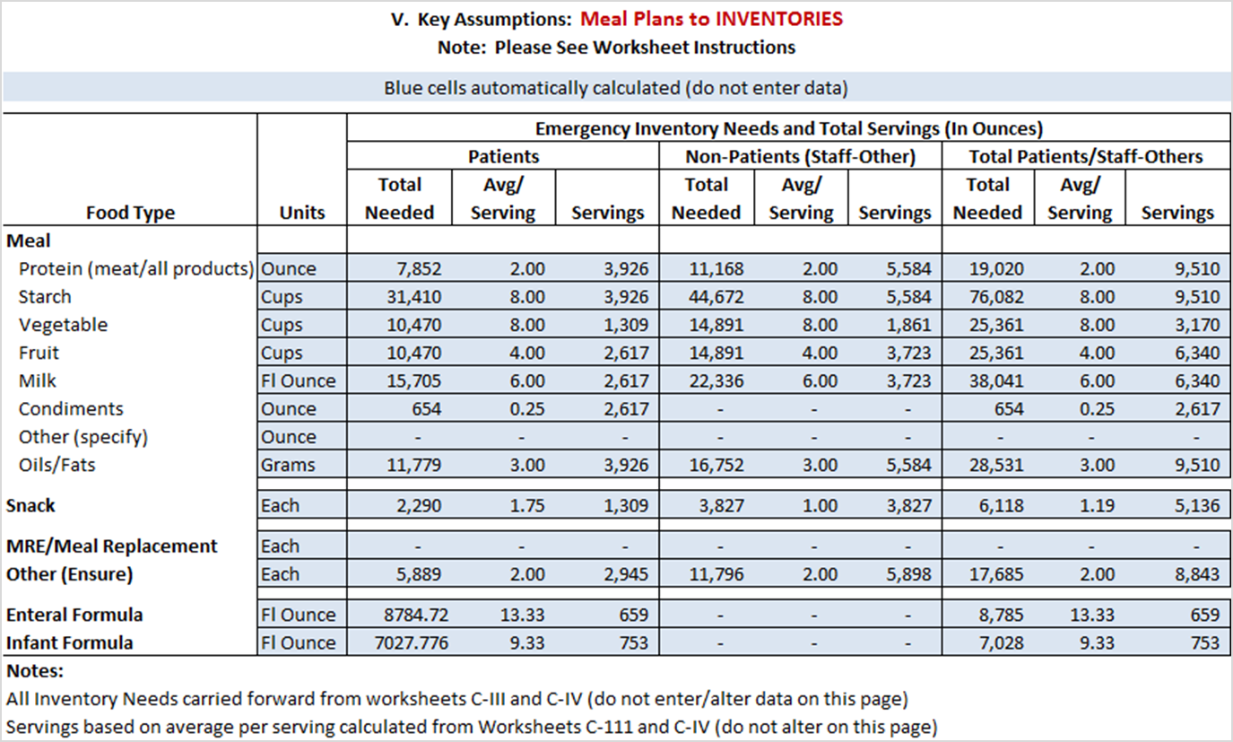
Providence Saint Joseph Medical Center
Assumptions – C-V Inventory-Servings Summary
Notes:
This is a summary resulting from the assumptions you have entered.
One thing that strikes me is that your protein, vegetables, fruit and milk requirements would all be close to double if you do not plan for an alternative.
Carol, how would you use this summary to plan for your inventory?
Carol:
We plan to use the inventory format provided to identify the specific products and quantities needed by category – for example, proteins, starches, vegetables, etc. By identifying inventory by the categories

Slide 39
Summary
  Hospital Emergency Food Supply Planning is tied to broader Hospital Emergency Operations Plan
  Emergency Food Guidance and Toolkit is scalable, and documents work you already do; remember there are regulatory minimums
  Recognize your potential physical, staffing and resource limitations in developing your plan
  Address water/hydration responsibilities (narrative)
  Transition your plans –
    Target is not a plan and does not belong in your plan
    Set a target but put in plan when met

Slide 40
Thank you
For additional information, please visit
the California Hospital Association’s Hospital Preparedness Program at
www.calhospitalprepare.org

Slide 41
CHA’s Hospital Preparedness Program
CHA’s Hospital Preparedness Program provides ongoing support to California hospitals and health systems in all-hazard’s disaster planning and response. CHA coordinates the annual Disaster Planning for California Hospitals Conference — the largest gathering of hospital emergency preparedness planners in the state.
For additional information, visit www.calhospitalprepare.org.

Slide 42
Thank You to Our Funders
The materials covered by this presentation were developed by the CHA Hospital Preparedness Program with grant funds provided by the U.S. Department of Health & Human Services Assistant Secretary for Preparedness & Response Hospital Preparedness Program and awarded by the California Department of Public Health.
No part of these materials shall be copied or utilized for monetary gain. Please do not share, distribute, transmit or reproduce without prior written consent of California Hospital Association (CHA).

