Slide 1
Office of Health Care Affordability Background

Slide 2





OHCA’s Main Objectives and Responsibilities
Increase transparency on spending and quality
Set spending targets for the health care field
Enforce compliance, including through financial penalties
Monitor and review market transactions
Establish new standards, including for quality, equity, workforce

Slide 3
Division of Roles and Responsibilities
Office/Director
Establish reporting requirements
Board
Establish spending targets and associated methodologies and adjustments
Advisory Committee
Provide input and recommendations on matters before the office, including data reporting requirements and spending targets
Analyze and publish reports on health care spending
Advise on and carry out progressive enforcement actions
Monitor and review market transactions
Define sectors and, as appropriate, geographic regions and individual health care entities
Approve range and scope of administrative penalties

Slide 4
Board of Directors
  Dr. David Carlisle – President and CEO of Charles R. Drew University of Medicine and Science (Governor appointee)
  Dr. Mark Ghaly – CalHHS Secretary (ex officio, board chair)
  Sandra Hernandez – President and CEO of CHCF (Governor appointee)
  Richard Kronick – Professor, University of California, San Diego (Governor appointee)
  Ian Lewis – NUHW Director of Research (Assembly appointee)
  Elizabeth Mitchell – President and CEO of the Purchaser Business Group on Health (Governor appointee)
  Don Moulds – CalPERS Chief Health Director (ex officio, nonvoting member)
  Dr. Richard Pan – former Senator (Senate appointment)

Slide 5
“Health Care Entities” Are Subject to Spending Targets
Health Care Entities
Payers
Providers
Fully-Integrated Delivery Systems
A combined health plan and hospital system that exclusively contracts with a single physician organization within each geographic region
⋅Health plans and insurers
⋅Public health care programs
(Medicare and Medi-Cal)
⋅Third-party administrators
⋅Hospitals
⋅Physicians
⋅Primary care and specialty clinics
⋅Nursing facilities
⋅Ambulatory surgical centers
⋅Imaging facilities
⋅Clinical laboratories

Slide 6
Exempt Health Care Providers and Suppliers
Various health care providers and suppliers are directly or indirectly exempt:
Physician organizations with fewer than 25 physicians*
Dentists
Pharmacies (including manufacturers and retail pharmacies)
Durable medical equipment suppliers
Home health agencies
Emergency medical transportation
*Physician organizations with fewer than 25 physicians that are determined to be high-cost outliers may have their exemption removed
These entities will not specifically be subject to reporting requirements, spending targets, or market oversight.
However, the spending associated with exempt entities generally will be included in payers’ expenditures and the revenues attributed to providers.

Slide 7
Timeline
2024
March 11 – Comment period on spending target ends
March 19 – OHCA advisory committee meets to discuss the proposed spending target
March 25, April 24, or May 22 – OHCA board adopts the first statewide spending target
Sept. 1 – OHCA collects 2022 and 2023 total health care expenditure (THCE) data
2025
Jan.-Dec. – Non-enforceable statewide spending target in effect
June 1 – OHCA releases baseline report on 2022 and 2023 spending
Sept. 1 – OHCA collects 2023 and 2024 THCE data
2026
Jan.-Dec. – Enforceable statewide spending target in effect
June – OHCA releases baseline report on 2023 and 2024 spending
Sept. 1 – OHCA collects 2024 and 2025 THCE data

Slide 8
Timeline (Continued)
2027
Jan-Dec – Enforceable statewide spending target in effect
June 1 – OHCA releases first annual report on performance against the 2025 spending target
Sept. 1 – OHCA collects 2025 and 2026 THCE data
Oct. 1 – Board must define sectors
2028
Jan.-Dec. – Enforceable statewide spending target in effect
June 1 – Board must adopt spending targets by sector
June – OHCA releases annual report on performance against the 2026 spending target
Sept. 1 – OHCA collects 2026 and 2027 THCE data
2029
Jan.-Dec. – Enforceable statewide and sector spending targets in effect
June – OHCA releases annual report on performance against the 2027 spending target
Sept. 1 – OHCA collects 2027 and 2028 THCE data

Slide 9
California Health Care and Hospital Landscape

Slide 10
California’s Aging Population Is Growing Faster
Key Observations
The 65 and older Population in CA has been growing at 2.6% per year on average compared to 2.1% nationally and 2.3% for selected peer states.
A larger elderly population will have both higher rates of health care ailments, resulting in increased demand for services, as well as more coverage through programs like Medicare, which further increases the demand for services.
Sources – : US Census Population Estimates via County Health Rankings & Roadmaps

Slide 11
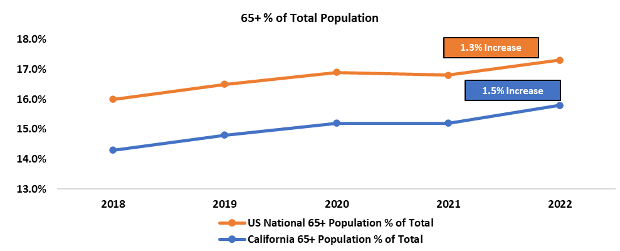
California’s Aging Population Is Driving Increases in
Net Medicare Revenue at a Greater Rate than the Nation
California has a lower age 65+ share of total population than the national average but is growing at a greater rate
Growth in Net Medicare Revenue ⁽¹⁾
Age 65+ Share of Total Population ⁽²⁾
Growth in hospital net Medicare revenue is lower than the proposed cost target, but nearly three times that of the nation and other cost target states
Sources – (1) HCRIS Medicare Cost Report Data (Fields – Net Medicare Revenue); (2) CDC WONDER data aggregated by America’s Health Rankings

Slide 12
CA Uninsured Adults Population is
Declining at Nearly Double the National Rate
Key Observations
The number of uninsured adults in the US and CA has declined between 2015 and 2020.
Over that period, this population has declined 8% per year on average, compared to 4.2% nationally and 4.5% in selected peer states.
Fewer uninsured adults results in higher health care expenditures.¹
Sources – US Census Small Area Income and Poverty Estimates via County Health Rankings & Roadmaps
1. The Uninsured Do Not Use The Emergency Department More—They Use Other Care Less | Health Affairs

Slide 13
California Labor Expense Growth Is Faster than the Nation
Labor expenses are increasing faster in California than the nation
The average annual salary for California registered nurses, to use one example, has increased 42% in 10 years. Nationally, average nurse salaries increased 31% over the same period
The growth rate for hospitals may be different than other health care providers - hospitals often pay a premium for the same position type
Annual Salaries (National Data) for Registered Nurses by Setting
14%
Change
13%
Change
15%
Change
11%
Change
Source – The Bureau of Labor Statistics

Slide 14
Gross State Product Is Growing at a Faster Rate in CA
Key Observations
Most cost target setting states use Gross State Product growth rate as the main driver and the proxy for what beneficiaries could afford.
Gross State Product in California has increased at 5.9% per year on average between 2018 and 2022, which is greater than the national average of 5.7% and lower than the cost target states’ average of 6.1% during the same period.
Sources - U.S. Bureau of Economic Analysis

Slide 15
Medical Inflation Is Growing Faster than Overall Inflation
Key Observations
National CPI-Med has been growing at 2.8% per year whereas CPI-U has been growing at 2.6% per year between 2014-2022.​
California has had an average 3.5% growth rate of CPI-Med, which is higher than both the national average of 2.8% and the shown cost target states’ average of 2.2% between 2014 and 2022.
Notes:
Average of the CPI-Med for Los Angeles-Long Beach-Anaheim, CA, San Francisco-Oakland-Hayward, CA, San Diego-Carlsbad, CA, and Riverside-San Bernardino-Ontario, CA areas for available years are used as a proxy for California.
Boston-Cambridge-Newton, MA-NH area is used as a proxy for Massachusetts.
Portland-Salem, OR-WA area is used as a proxy for Oregon. Data is available until 2017.
Seattle-Tacoma-Bellevue WA area is used as a proxy for Washington.
Sources – U.S. Bureau of Labor Statistics

Slide 16
The Ratio of Primary Care Physicians to Population Is
Growing
Key Observations
The ratio of primary care physicians (PCPs) to population in CA has been growing​.
This ratio is growing faster than the national rate.
A higher primary care physician to population ratio is likely to result in more patient services provided as well as a higher costs overall.
Sources – US Census Small Area Income and Poverty Estimates via County Health Rankings & Roadmaps

Slide 17
Weekly Wages Are Growing
Key Observations
On average, CA has had higher weekly wage growth (4.4%) than the US (3.9%) between 2014 and 2023.​
Shown cost target states experienced higher wage growth over the same period, at 4.9%. ​
In recent years, CA has had lower wage growth than shown cost target states.
Sources – U.S. Bureau of Labor Statistics

Slide 18
Preventable Hospital Stays Are Declining
Key Observations
The rate of preventable hospital stays in California has declined at 10% per year on average between 2017 and 2020.
The decline in CA is less than the national average decline rate of 14%.
Shown cost target states have decreased hospital stays at 9.6% per year on average during the same years.
Given the decreases that have already occured, it is likely unrealistic to expect large reductions in spending through utilization reduction
Sources – US Census Small Area Income and Poverty Estimates via County Health Rankings & Roadmaps

Slide 19
Total Hospital Beds per 1,000 People Are Relatively Flat
Key Observations
Total hospital beds per 1,000 people have been trending down nationally, averaging -0.5% per year between 2016 and 2021. ​
In CA, total hospital beds per 1,000 people have grown 0.9% per year between 2016 and 2021. ​
Sources – KFF

Slide 20
California Has a Higher Unionization Rate Than the US
Key Observations
CA has a higher unionization rate of 16.1% than the US average of 10.1% in 2022 and on average membership nationally decreased by 1.2% while only by 0.2% in CA between 2014 and 2022. During the same time, shown peer states increased unionization by 0.3%.
Sources – U.S. Bureau of Labor Statistics

Slide 21
When Adjusted, California’s Total Health Spending Is Low
Personal Health Care (PHC) spending is the most aggregated measure of spending provided by the Centers for Medicare & Medicaid Services (CMS) in its National Health Expenditure data at the state level
PHC includes most types of spending for providers and excludes government and insurance administration costs as well as research
When adjusted for cost of living, California’s per capita PHC is low
Per Capita PHC Spending, Nation vs. California
% Growth Since 2010
Nation: 45%
California: 59%
California unadjusted per capita PHC expenditures rank in 2020: | 22
California per capita PHC expenditures rank in 2020 adjusted* for cost of living: | 41
California unadjusted per capita PHC expenditures rank in % growth from 2010 to 2020: | 5
1= Highest/Worst/Fastest Growing, 50= Lowest/Best/Slowest Growing
Source: CMS’ historical national health expenditure data
*Adjustment used The Bureau of Economic Analysis’ Regional Price Parities by State and Metro Area for 2021

Slide 22
California’s Adjusted Hospital Spending Is Also Low
Similar to PHC, when adjusted for cost of living, California’s per capita hospital spending is low
Per Capita Hospital Spending, Nation vs. California
% Growth Since 2010
Nation: 47%
California: 66%
California unadjusted per capita hospital expenditures rank in 2020: | 33
California per capita hospital expenditures rank in 2020 adjusted* for cost of living: | 41
California unadjusted per capita hospital expenditures rank in % growth from 2010 to 2020: | 4
1= Highest/Worst/Fastest Growing, 50= Lowest/Best/Slowest Growing
Source: CMS’ historical national health expenditure data
*Adjustment used The Bureau of Economic Analysis’ Regional Price Parities by State and Metro Area for 2021

Slide 23
California Pays More for Goods and Services
On average, California regional price parity (RPP) is historically 11.0% higher than the US, whereas average RPP for the three cost target states shown was only 5.2% higher
The price disparity for all goods and services in California vs the US has grown over the past 10 years
Regional Price Parity 2013 – 2022
While health care is only a subset of the basket of goods and services shown, all levels of health care are likely to be impacted as higher prices permeate to both the patient cost of health care as well as the provider cost of supplies and overhead
Sources – (1) U.S. Bureau of Economic Analysis

Slide 24
CA Hospitals’ Operating Margins Have Deteriorated Faster Than the Nation
California hospital operating expenses outpace net patient revenue growth at a greater disparity than the nation, causing more rapid deterioration of operating margin compared to the national average
Income Statement Growth Rates (2018 – 2022) ⁽¹⁾
California
Net Patient Revenue | 4.4% Annual Growth (CAGR)
Operating Expenses | 6.1% Annual Growth (CAGR)
Operating Margin | 6.9% Cumulative Decrease
National Average
Net Patient Revenue | 5.5% Annual Growth (CAGR)
Operating Expenses | 6.5% Annual Growth (CAGR)
Operating Margin | 4.0% Cumulative Decrease
Note: Calculation examples of CAGR & cumulative change are included in the appendix
Even without potential restrictions to hospital revenues, annual growth in net patient revenue for California hospitals is lower than the nation by 1.1%
Note that all analysis excludes Kaiser Permanente hospitals due to inconsistent reporting of hospital-level revenue & assets across 2018 – 2022 data
Sources – (1) HCRIS Medicare Cost Report Data (Fields: Net Patient Revenue, Total Operating Expenses)

Slide 25
Patient Care Costs Have Historically Driven Higher
Operating Expenses
Increases in labor and supply costs drive the majority of hospital operating expense growth
California health care cost inflation (CPI-Med) grew at 3.3% annually from 2018 – 2022 ⁽³⁾, which would not allow for true cost growth in a 3% cost target scenario
California Hospital Statewide Pro Forma P&L ⁽¹⁾
Hospitals may be forced to reduce supply of services in order to maintain financial viability
Notes:
Pro Forma P&L based on 340 California hospitals with minimal data inconsistencies from 2018 to 2022
HCAI other operating revenue as a % of net patient revenue is applied to HCRIS net patient revenue
Sources – (1) HCRIS Medicare Cost Report Data (Fields – Net Patient Revenue, Total Salaries, Fringe Benefits, Contract Labor, Total Med/Surg Supply Costs, Total Overhead Costs, Depreciation, Interest, Total Operating Expenses); (2) HCAI (Fields – Other Operating Revenue); (3) BEA

Slide 26
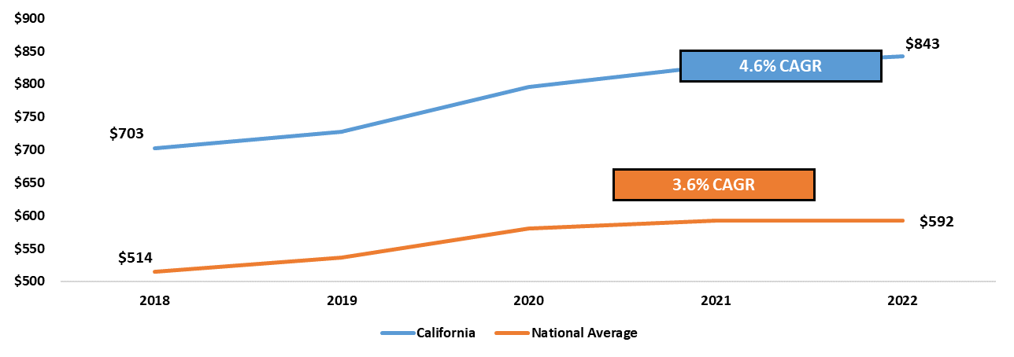
California Hospitals Pay More for Supplies
Even after adjustments for volume, increases in supply costs exceed California medical inflation (CPI-Med) of 3.3% ⁽¹⁾
California Med/Surg Supplies per Adjusted Patient Day ⁽²⁾
Hospitals would likely seek out more affordable supplies in a 3% cost target scenario, which would potentially impact the quality of care delivered
Sources – (1) US Bureau of Economic Analysis (2) HCRIS Medicare Cost Report Data (Fields – Total Med/Surg Supplies, Adjusted Patient Days)

Slide 27
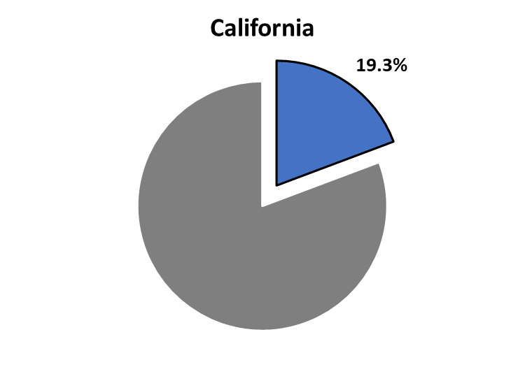
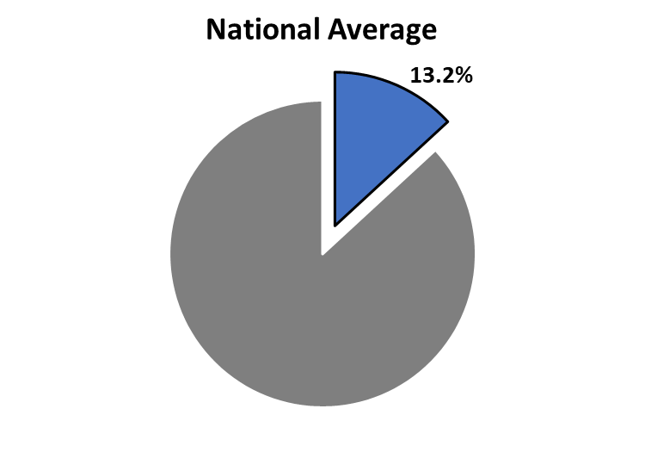

California Net Medi-Cal Revenue Share
Is Higher than the National Average
Even though the Medi-Cal share of California’s population has increased since 2018, Medi-Cal percent of hospital net patient revenue has remained constant
Medicaid % of Population ⁽¹⁾ ⁽⁴⁾
Hospital Net Medicaid Revenue as a % of Net Patient Revenue (2022) ⁽³⁾
$24.5B
Net Medicaid Revenue
Other Net Patient Revenue
Sources – (1) Enrollment data: Medicaid.gov (2) Cost Target State Basket defined on slide 8; (3) HCRIS Medicare Cost Report Data (Fields – Net Medicaid Revenue, Net Patient Revenue) (4) Population Data: KFF

Slide 28
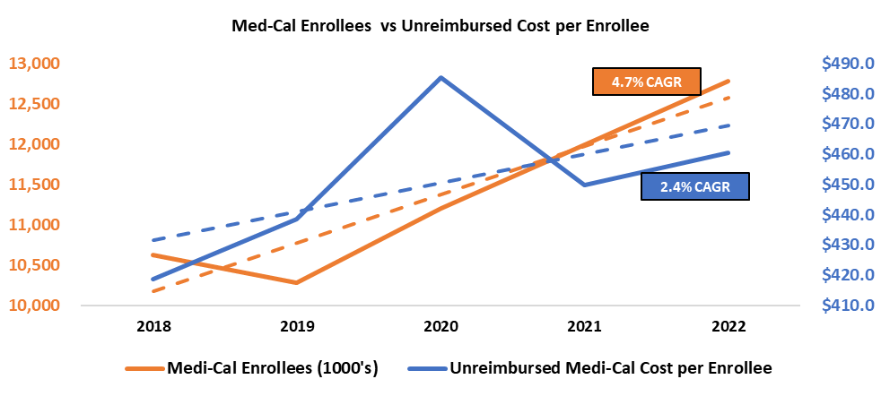
Medi-Cal Losses Are Growing Faster
Than Enrollment
Net Medi-Cal hospital revenue increased by 4.6% annually, but unreimbursed Medi-Cal costs grew faster at 7.3% annually
Medi-Cal Unreimbursed Cost % of Net Revenue ⁽¹⁾
Medi-Cal Enrollees vs Unreimbursed Costs per Enrollee ⁽²⁾
As unreimbursed cost per enrollee increased by 2.4% annually, future enrollment expansion will likely continue to contribute negatively to hospital financial performance. Using an estimated increase in Medi-Cal enrollment of 710k in 2024 ⁽³⁾, the 2022 value of $460 in unreimbursed costs per enrollee would equate to a statewide impact of $322M in additional losses.
Sources – (1) HCRIS Medicare Cost Report Data (Fields – Total Unreimbursed Medicaid Costs, Net Patient Revenue); (2) KFF; (3) UC Berkely Labor Center

Slide 29
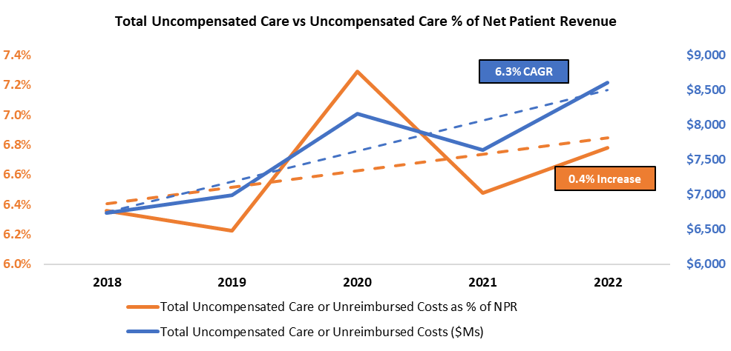
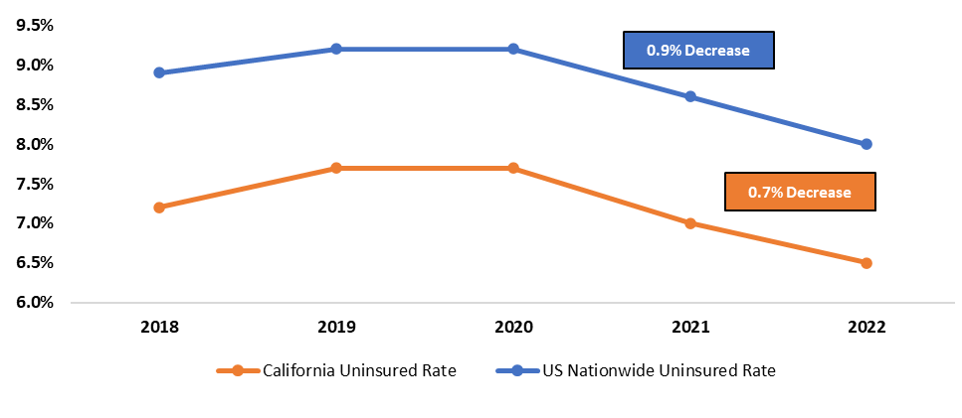
Lowering the Uninsured Rate Does Not
Necessarily Reduce Uncompensated Care
While California’s uninsured percent of total population decreased, uncompensated care increased as a percent of total hospital net patient revenue
Uninsured Adult % of Total Population ⁽¹⁾
California Hospital $UCC vs UCC % of NPR ⁽²⁾
Note: 2019 – 2020 held constant due to gap in CDC data
In the face of a 3% cost target, the State of California would need to address uncompensated care growth so that hospital losses are not further escalated
Sources – (1) CDC Data aggregated by America’s Health Rankings; (2) HCRIS Medicare Cost Report Data (Fields – Total Uncompensated Care or Unreimbursed Costs, Net Patient Revenue)

Slide 30
California Hospitals Are More
Leveraged than the National Average
High long-term liabilities per bed suggests that California hospitals have taken on debt to finance operations or investments
California LongTerm Liabilities per Bed vs the Nation ⁽¹⁾
If faced with additional pressures from a cost target, California hospitals would likely have to prioritize financial viability over improving patient care when making investment decisions due to unfavorable debt & liquidity positions
Sources – (1) HCRIS Medicare Cost Report Data (Fields – Total Long Term Liabilities, Number Beds, Cash on Hand, Investments, Temporary Investments, Total Operating Expenses, Depreciation)

Slide 31
Debt to Capitalization Ratio for California Hospitals Is
Higher than the Nation and Growing Faster
Given that California hospitals likely need to invest more capital into infrastructure to meet seismic compliance needs, the unfavorable variance of 17.0% vs the nation is likely to grow in future years
Debt to Capitalization Ratio by State ⁽¹⁾
Years with active cost target
Sources – (1) HCRIS Medicare Cost Report Data (Fields – Total Liabilities, Total Assets)

Slide 32
OHCA’s Proposed Target

Slide 33
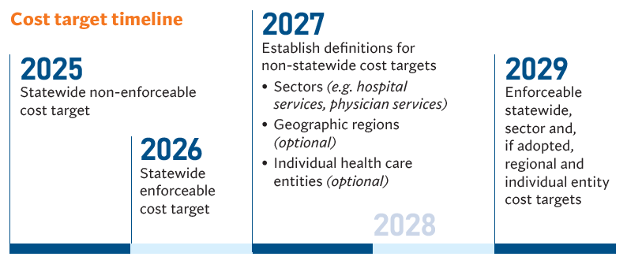
Spending Targets Background
Key Statutory Requirements on Spending Targets
Based on a target percentage for annual growth in per capita total health care expenditures
Promote affordability and a predictable and sustainable rate of change in costs
Set with consideration of economic indicators, like inflation, and population-based measures, like aging
Maintain quality, equity, and workforce stability
Optional or required adjustments to spending targets to account for:
  Risk of patient populations
  Equity
  Inflation
  Labor costs
  Policy changes
  Payer mix
  Prices of health care technologies
  Emerging diseases
  Growth in nonsupervisory organized labor costs
  High-cost, low-quality health care entities
What’s behind a spending target?
Based on both reimbursement and utilization levels
Performance will be assessed based on payers’ costs and providers’ revenues
Per capita:
  For payers, measured on a per-enrollee or per-insured basis
  For providers, initially measured on an attributed-patient basis

Slide 34
OHCA Staff Recommendation
3% Statewide Spending Target for 2025-2029
To promote improved affordability, the annual per capita health care spending growth target percentage should be below the long-term health care cost growth trend of 5%.
To promote transparency and public accessibility, the basis for establishing a statewide spending target should be a single economic indicator.
The methodology should rely on an indicator of consumer affordability, specifically, median family income, because it captures retirees and others not in the labor market.
The methodology should rely on historical data over projections. Specifically, the methodology is the average annual growth in median household income in CA over for the period 2002-2022.
Initial targets should be set for five calendar years to provide for sufficient planning.

Slide 35
Other States Have a Similar Framework for Establishing Health Care Cost Growth Targets
Comparing Target-Setting Methodology
The proposed target of 3% annual cost growth for CA would take effect in 2025, remaining static over a five-year period
The 3% target is based on a weighted average of California historical median household income growth over a 20-year period (2002-2022)
Unlike other cost target states, the final OHCA recommendation does not include a wind-down period for the delivery system to adjust
Throughout this analysis, comparing California to the “Cost Target State Basket” is the sum or average of metrics for the seven cost target states listed to the right
US States with Active Cost Growth Targets ⁽¹⁾
 | 2018 | 2019 | 2020 | 2021 | 2022 | 2023 | Last Period
Massachusetts | 3.1% | 3.1% | 3.1% | 3.1% | 3.1% | 3.6% | 3.6% (2024)
Delaware |  | 3.8% | 3.5% | 3.3% | 3.0% | 3.0% | 3.0% (2023)
Rhode Island |  | 3.2% | 3.2% | 3.2% | 3.2% | 6.0% | 3.3% (2027)
Oregon |  |  |  | 3.4% | 3.4% | 3.4% | 3.0% (2030)
Connecticut |  |  |  | 3.4% | 3.2% | 2.9% | 2.9% (2025)
Washington |  |  |  |  | 3.2% | 3.2% | 2.8% (2026)
New Jersey |  |  |  |  |  | 3.5% | 2.8% (2027)
Active Cost Targets vs Actual Net Patient Revenue Growth
With the exception of 2020, net patient revenue growth for Delaware hospitals is consistently more than twice that of the active cost target
Statewide Hospital Net Patient Revenue Growth ⁽²⁾
 | 2018 | 2019 | 2020 | 2021 | 2022 |  | CAGR
Massachusetts | 10.1% | 0.4% | -4.4% | 13.8% | 3.4% |  | 3.1%
Delaware | 4.9% | 6.3% | -4.8% | 14.1% | 7.5% |  | 5.5%
Rhode Island | 5.8% | 3.1% | -7.1% | 10.7% | 1.2% |  | 1.8%
Oregon | 6.0% | 4.5% | -0.4% | 7.7% | 8.4% |  | 5.0%
Connecticut | 8.0% | 7.2% | -4.1% | 12.0% | 5.9% |  | 5.1%
Washington | 6.4% | 3.6% | -3.2% | 13.2% | 2.6% |  | 3.9%
New Jersey | 1.3% | 4.5% | -6.5% | 10.3% | 16.9% |  | 6.0%
Early implementation of cost growth targets does not appear to have a uniform effect on hospital net patient revenue growth
Years with active cost growth target
Sources – (1) OHCA December Board Meeting (2) HCRIS Medicare Cost Report Data (Fields: Net Patient Revenue)

Slide 36
OHCA Proposal Would Make California an Outlier

Slide 37
Enforcement Against Spending Targets
Pre-Enforcement Process
Notify entities that have exceeded their spending target
Progressive Enforcement Process
Provide technical assistance
Compel entities to provide public testimony on why they exceeded their target
Allow entities to respond with information justifying their spending growth
Modify findings to the extent spending growth is justified
Report which entities have unjustifiably exceeded their target
Impose a performance improvement plan (PIP)
Assess administrative penalties
Massachusetts Case Study
January 2022: A PIP is imposed on Mass General Brigham after the state found:
$293 million in cumulative commercial spending growth in excess of the target over five years
Higher prices than other providers
Inadequate cost containment strategies
September 2022: State approves PIP on Mass General, committing it to reduce annual spending by $128 million through
Price reductions
Reducing utilization (e.g., MRIs)
Shifting care to lower-cost sites
Increasing the use of alternative payment models
2028
First enforcement actions on cost targets expected (for 2026 targets)

Slide 38
Other States’ Targets Are Not Attainable

Slide 39
A 3% Cost Target Beginning in 2025 Is Too Low and Does
Not Give an Ample Glide Path for California Hospitals
OHCA needs to clarify the following components if hospitals are expected to address the existing financial pressures and comply with a 3% cost growth target:
Accountability Mechanisms:
OHCA’s initial outline for enforcing the proposed target is vague, but cites that California’s statute “provides stronger enforcement authority”
What threshold determines a performance improvement plan vs financial penalties?
Lack of Phased Implementation:
Only one of the seven other cost target states (Rhode Island) did not have a ramp-up period for adjusting statewide performance to its final cost target
OHCA has not provided rationale for immediate implementation of a 3% target and holding it constant
Volume Growth:
If hospital revenue increases are primarily volume-driven and patient cost per case is flat or below the cost target, would this result in a penalty?
3% is too low, and CHA analysis of cost growth drivers should be used to estimate an appropriate target

Slide 40
California Hospitals May Have Less Opportunity to
Reduce Staffing Without Adverse Impacts
On average, California’s price parity for goods and services is 11% higher than the nation, which contributes to hospital labor costs being 28% higher than the national average on a per employee basis
Salaries & Benefits per Employee ⁽¹⁾
Employees per Bed ⁽¹⁾
*Employees based on paid hours
*Beds recorded in HCRIS data are staffed beds
California hospitals pay more in labor expenses per employee and they may not have the ability to reduce labor to the extent of other cost target states given that staffing is lower by 1.1 employees per bed in comparison
Sources – (1) HCRIS Medicare Cost Report Data (Fields – Total Salaries, Total Fringe Benefits, Number of Employees, Number Beds)

Slide 41
Seismic Investment Would Delay Necessary
Investments in Access and Patient Care
As of 2022, the majority of CA hospital capital expenditure (58.4%) is invested into buildings PP&E, which is higher than the national average of 35.6%
California Estimated Annual Compliance Spend ($Ms) ⁽²⁾
% of Total Capital Expenditure (2022) ⁽¹⁾
/
Assuming no increase to total capital spend, estimated additional investment of $2.7B would crowd out the ability to invest in improvements to patient care and access
A 3% cost target would make it increasingly difficult to generate capital, especially given historical operating performance and balance sheet conditions of California hospitals
Sources – (1) HCRIS Medicare Cost Report Data (Fields – Buildings Fixed Assets, Fixed Equipment, Major Moveable Equipment, Capital Expenditure)

Slide 42
Potential Impact of a 3% Target on Revenue
Hospital Net Patient Revenue Relative to 3% Target
(5.5% annual average)
Revenue in Billions
$20.7 Billion (12.4%) Difference
Sources – CHA analysis of California Department of Health Care Access and Information Annual Financial Disclosure Report Data

Slide 43
Foregone Revenues Will Lead to Expense Reductions
Hospitals will not be able to reduce expenses in ways that don’t impact jobs, quality, and access
If $20.7 Billion Less Revenue Was Matched with an Equal Reduction in Operating Expenses…
All non-labor operations
54% -
-$11.2 billion
46% -
-$9.5 billion
58,000 Fewer Workers

